Slide 1
Intelligently Monitor SQL Server Agent
Raymond Barley
Business Intelligence Architect
raymondbarley@itresourcepartners.com

Slide 2
Agenda
Problem Scenario
SQL Server Agent Tables
Data Model
Demo and Code Review

Slide 3
Problem Scenario
SQL Agent jobs provide critical data for reports and dashboards
Reports and dashboards need to be available by specific times
Source data may be available later than required
Job failures cause data to be available later than required
We need to know when reports and dashboards will be available
Build a SQL Agent job to collect data and a Power BI report to tell us when a currently running SQL AGENT job will be done

Slide 4
Demo
Show the MonitorActiveJobs Power BI report

Slide 5
SQL Server Agent Tables Used (msdb database)
sysjobs - one row for each SQL Agent job
sysjobsteps - one row for each step in a job
sysjobhistory - one row for each job and job step execution
syssessions - 1 row each time SQL Agent service starts (session_id)
sysjobactivity - one row for each job and session_id combination

Slide 6
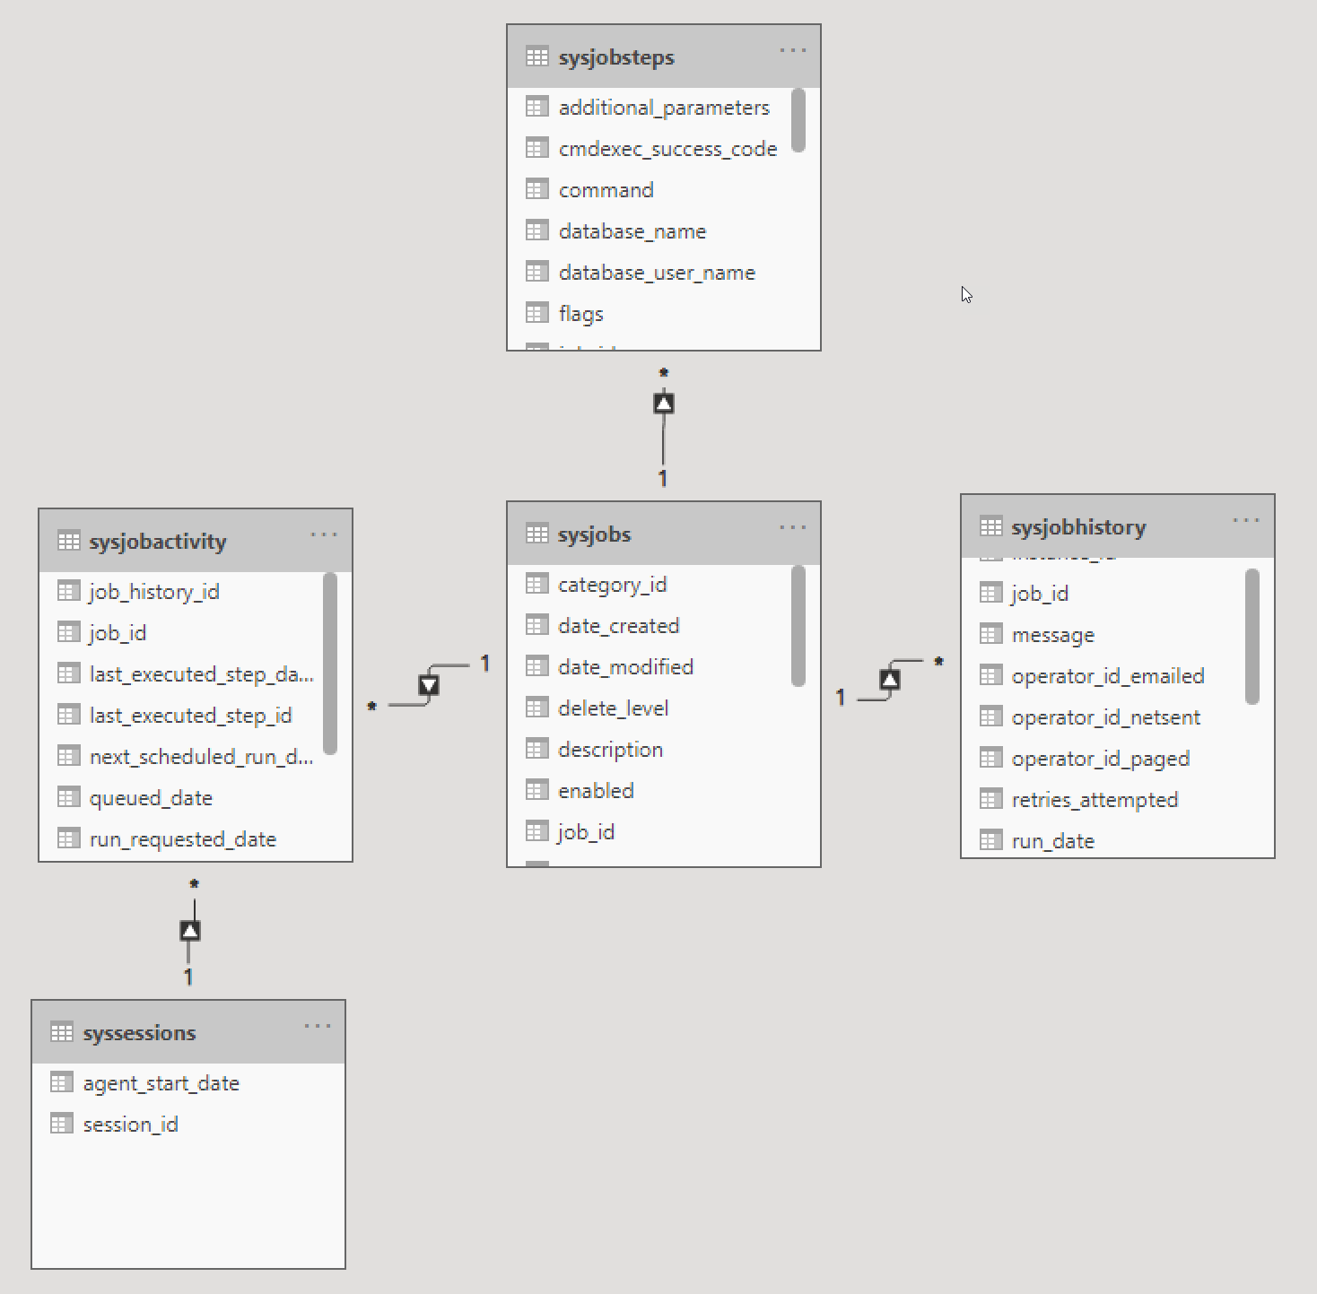
msdb Database Tables Used

Slide 7
Notes on msdb.dbo.sysjobhistory Columns
The table contains the history for jobs and job steps
step_id is 0 for a job outcome else it matches the step_id for a row in the msdb.dbo.sysjobsteps table
run_date is an INT formatted as YYYYMMDD; it is the date that the job started running
run_time is an INT formatted as HHMMSS; it is the time that the job started running
run_duration is an INT formatted as HHMMSS; it is the number of hours, minutes and seconds that the job or job step executed
Code samples will show how to convert these to a DATETIME or INT that is the number of seconds a job or job step ran

Slide 8
Dimensional Modeling
Introduced by Ralph Kimball in 1996
Fact tables, Dimension tables, Star schema
Snapshot used in this presentation is the Periodic Snapshot Fact Table
Represents the data at a specific point in time

Slide 9
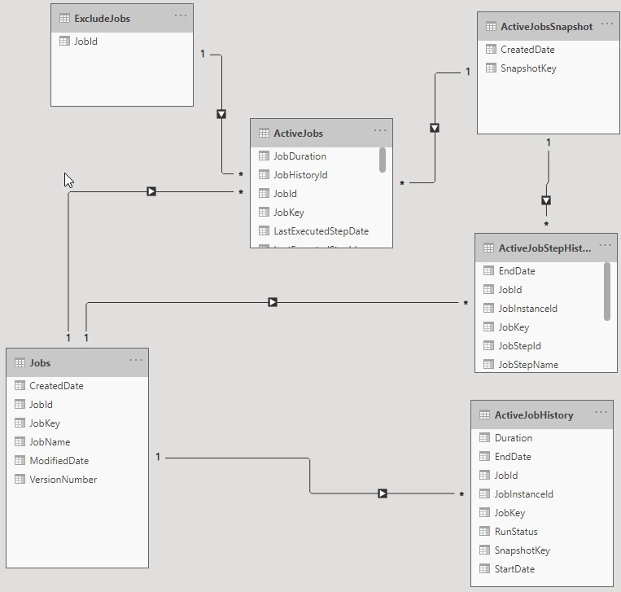
Data Model
ActiveJobsSnapshot – 1 row each time job runs; used in Slicer
Active Jobs – SQL Agent jobs currently running at the time of the snapshot
Jobs – List of SQL Agent jobs that have ever been running at the time of a snapshot
ActiveJobHistory –history of successful job executions for the jobs in the snapshot
ActiveJobStepHistory – history of successful job step executions for the jobs in the snapshot
ExcludeJobs – jobs to exclude; e.g. job that captures the data for the current snapshot

Slide 10
Power BI
Shiny new tool in the toolbox
Power BI Desktop makes it relatively easy to develop simple reports
Works with many data sources
Works with SQL Server extremely well
Deploy on-premise to Power BI Report Server
Deploy to cloud with Power BI Service

Slide 11
Demo
Review SQL Agent data available in SQL Server Management Studio
Review stored procedure that extracts and loads SQL Agent data for jobs currently running
View Power BI report showing the details on SQL Agent jobs currently running

Slide 12
References
Monitor SQL Server Agent Job Activity with Power BI
https://www.mssqltips.com/sqlservertip/6598/sql-server-agent-monitoring-with-power-bi/
Build an Incremental ETL Process for a SQL Server Agent Data Mart
https://www.mssqltips.com/sqlservertip/6626/sql-server-agent-data-mart-incremental-load/

Slide 13
References
Kimball Dimensional Modeling
https://www.kimballgroup.com/data-warehouse-business-intelligence-resources/kimball-techniques/dimensional-modeling-techniques/
Periodic Snapshot Fact Table
https://www.kimballgroup.com/data-warehouse-business-intelligence-resources/kimball-techniques/dimensional-modeling-techniques/periodic-snapshot-fact-table/

Slide 14
References
Setup dbmail
https://www.mssqltips.com/sqlservertip/1100/setting-up-database-mail-for-sql-server/
Setup dbmail to use free email accounts
https://www.mssqltips.com/sqlservertip/2578/setup-sql-server-database-mail-to-use-a-gmail-hotmail-or-outlook-account/

